Slide 1
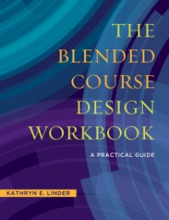
A webinar for faculty developers on The Blended Course Design Workbook: A Practical Guide
Author contact information:
Dr. Katie Linder
www.bcdworkbook.com
Twitter: @Katie__Linder

Slide 2
Webinar objectives
What is blended learning?
What do faculty need to know about blended teaching?
What do students need to know about blended learning?
Chapter overview
Book features
Faculty development program ideas
Bonus materials

Slide 3
What is blended learning?
Increasingly popular phenomenon
Replacement model – face-to-face course time is replaced with online content delivery
Face-to-face time often cut by 1/3 to 1/2
Credit hours stay the same
Requires additional technology integration and online content
Can allow for more autonomous, active, and independent learning

Slide 4
Benefits Challenges
Can create more time for active learning in class
Lets students experience course materials in a range of ways
More autonomous and independent learning can lead to more student buy-in
Offers faculty a new skillset for their teaching
Requires more up-front design and planning
Learning curve of technology and active learning for faculty and students
Faculty must give up some control over learning
Faculty often need assistance with design

Slide 5
What do faculty need to know?
A clear definition of what blended teaching is
Blended course design requires more up-front design and planning
Student use technology for social reasons, but may not be experienced with using it for learning
At first, students may struggle with time management and autonomous learning
Faculty shouldn’t try to incorporate too many tools at one time and overwhelm themselves and their students

Slide 6
What do students need to know?
Blended courses are not easier than face-to-face courses
Students will need to take more control of their learning activities outside of the classroom
Blended courses may require more and different communication strategies with their professor than students are used to
Blended courses require using technology for learning, which may be new to some students

Slide 7
Chapter overview
Introduction: Why Blended, Why Now?
One: Fundamentals of Blended Teaching and Learning
*Two: Writing Course Goals and Learning Objectives
Three: Assessing Student Learning in Your Blended Course
*Four: Online Assessment Tools
Five: Designing Effective Learning Activities
*co-authored

Slide 8
Chapter overview (cont.)
Six: Mapping Your Blended Course
*Seven: Getting to Know Your LMS
*Eight: Creating Social Presence in Your Blended Course
Nine: Finding Resources Online
Ten: Creating Multimedia Resources
*Eleven: Mobile Devices, Apps & Social Media
*co-authored

Slide 9
Chapter overview (cont.)
Twelve: The Blended Course Syllabus
Thirteen: Preparing Your Students for Success
Conclusion: Getting Ready to Launch
Glossary
Appendices – including sample syllabi, additional research citations, weekly combined task list, and more
References

Slide 10
Book features
Research overviews for each chapter
Interactive elements throughout including templates and checklists
Practical examples from blended instructors
Tasks for each chapter and specifically for LMS design
Questions for faculty & administrators
Glossary of terms

Slide 11
Faculty development programs
One-off workshops or series of workshops
Blended Course Design Institute (book based on 6-week model)
Simulates a blended experience with face-to-face meetings and online activities
Morning session on course design
Afternoon session on technology training and andragogy integration
Book can be used as a curriculum with activities modified as needed for institutional- specific information

Slide 12
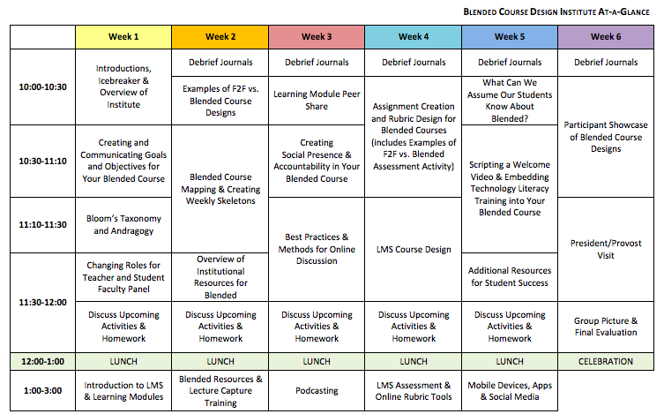
Sample Schedule: Blended Course Design Institute

Slide 13
Bonus materials
Handouts based on book content
Audio commentary
Interviews with co-authors
What is Blended Learning? Slide deck for presentation to faculty, students, or administrators
Bonus materials available at www.bcdworkbook.com

Slide 14
Dr. Katie Linder
Twitter: @Katie__Linder
Bonus materials available at www.bcdworkbook.com

